Slide 1



BANK LOAN ANALYSIS
Using MS SQL SERVER and Power BI

Slide 2
PROBLEM STATEMENT
Objective:
The primary objective of the Project is to provide a comprehensive and user-friendly interface for accessing vital loan data. It will serve as a one-stop solution for users seeking detailed insights into our loan portfolio, borrower profiles, and loan performance.

Slide 3

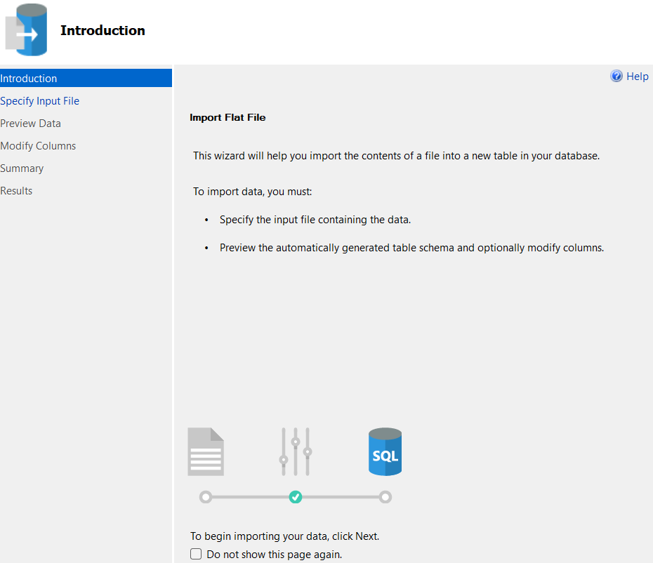

MS SQL SERVER
IMPORT
DATA

Slide 4

MS SQL SERVER
CREATING
DB

Slide 5
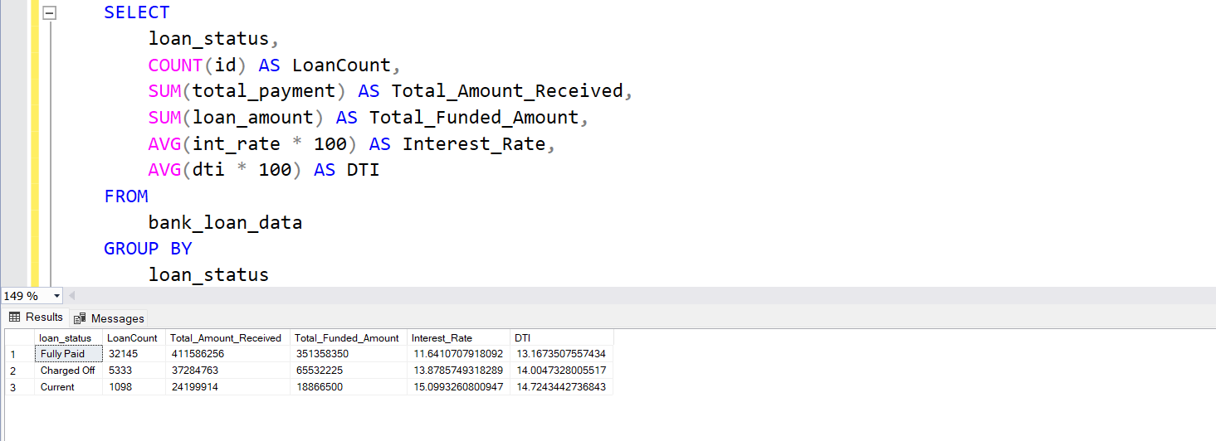
MS SQL SERVER
WRITING
QUERIES

Slide 6

SQL
USING SQL QUERIES TO SOLVE THE BUSINESS PROBLEMS

Slide 7


POWER BI
CONNECTING TO POWER BI
MS SQL SERVER

Slide 8
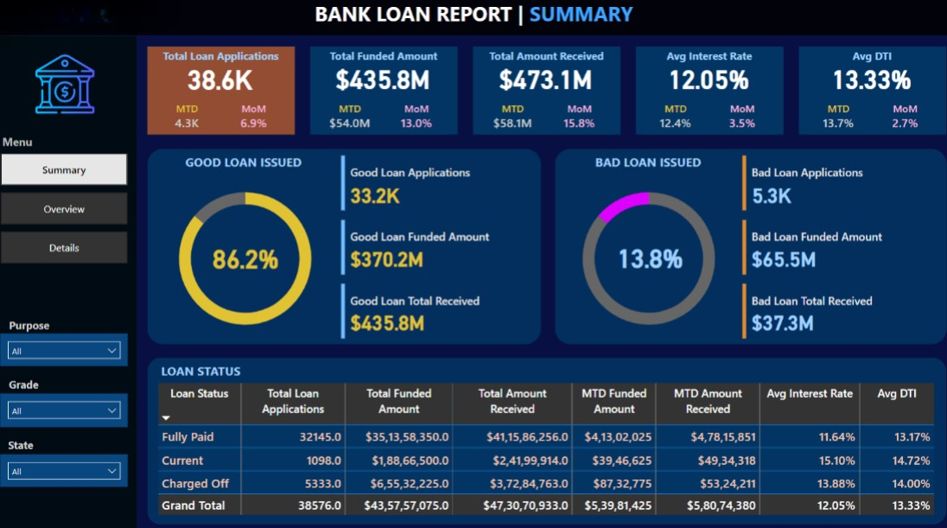
POWER BI

Slide 9
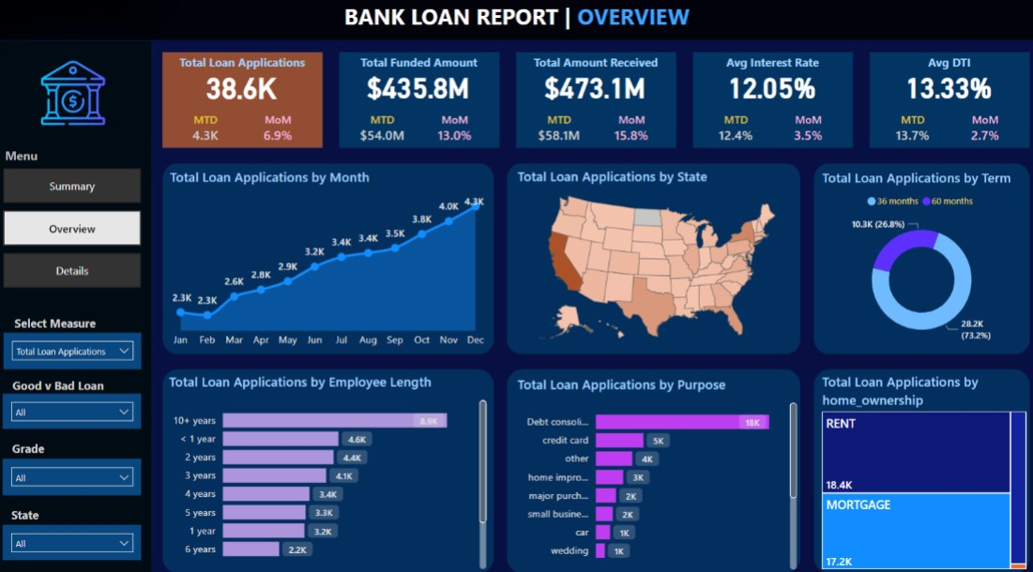
POWER BI

Slide 10
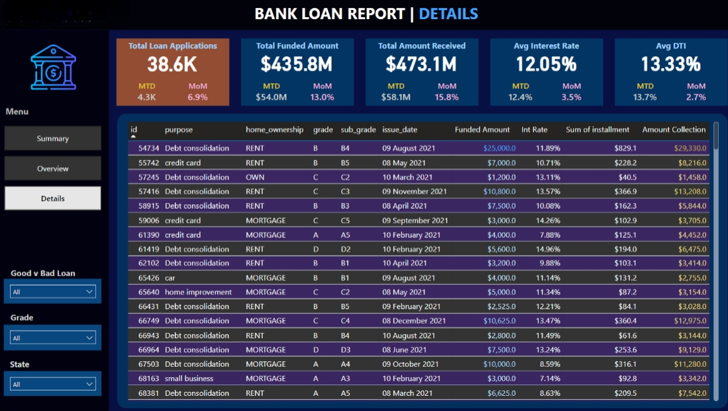
POWER BI

Slide 11
DASHBOARD 1: SUMMARY
Key Performance Indicators (KPIs) Requirements:
Total Loan Applications: To Track total and MTD loan applications with Month-over-Month (MoM) changes.
Total Funded Amount: To Monitor total and MTD funds disbursed, analyzing MoM trends.
Total Amount Received: To Assess total and MTD borrower repayments, observing MoM changes.
Average Interest Rate: To Calculate MTD interest rates, reviewing MoM variations for cost insights.
Average Debt-to-Income Ratio (DTI): To Evaluate MTD DTI, monitoring MoM fluctuations for financial health.

Slide 12
PROBLEM STATEMENT
DASHBOARD 2:
CHARTS
Monthly Trends by Issue Date (Line Chart): To identify seasonality and long-term trends in lending activities
Regional Analysis by State (Filled Map): To identify regions with significant lending activity and assess regional disparities
Loan Term Analysis (Donut Chart): To allow the client to understand the distribution of loans across various term lengths.
Employee Length Analysis (Bar Chart): How lending metrics are distributed among borrowers with different employment lengths, helping us assess the impact of employment history on loan applications.
Loan Purpose Breakdown (Bar Chart): Will provide a visual breakdown of loan metrics based on the stated purposes of loans, aiding in the understanding of the primary reasons borrowers seek financing.
Home Ownership Analysis (Tree Map): For a hierarchical view of how home ownership impacts loan applications and disbursements.

Slide 13
DASHBOARD 3: SUMMARY
Good Loan v Bad Loan KPI’s
Good Loan:
Good Loan Application Percentage
Good Loan Applications
Good Loan Funded Amount
Good Loan Total Received Amount
Bad Loan
Bad Loan Application Percentage
Bad Loan Applications
Bad Loan Funded Amount
Bad Loan Total Received Amount

Slide 14
THANK YOU

